Slide 1
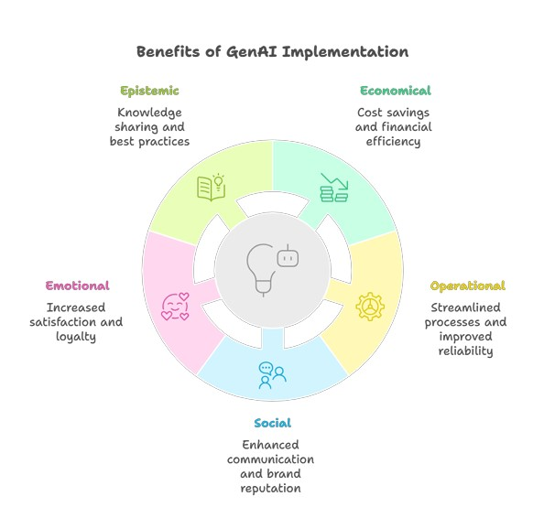
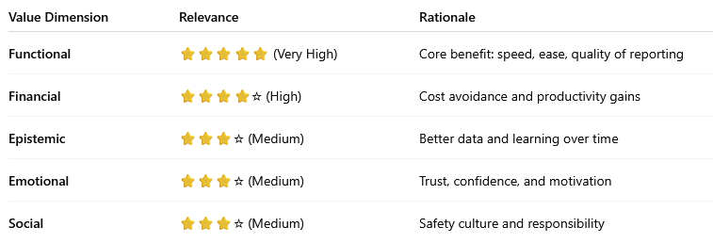
Value evaluation model: Incident reporting use case
BETA version
⚙️ Functional Value (Primary)
⏱️ Faster reporting
🖐️ Less effort
📋 Complete, standardized reports
🌍 Accessible on-site
Outcome: More incidents reported, faster fixes
💰 Financial Value
📉 Lower admin effort
🛑 Accident cost avoidance
📈 Productivity gains
Outcome: Reduced operational costs
📊 Epistemic Value
📚 Better incident data
🔍 Improved insights
📈 Stronger analytics
Outcome: Smarter prevention decisions
❤️ Emotional Value
🛡️ Higher confidence
🤝 Increased trust
⚡ Less reporting friction
Outcome: Employees feel safer and heard
🌱 Social Value
👥 Shared safety responsibility
🏅 Stronger safety culture
🌍 Corporate responsibility
Outcome: Better collaboration and reputation
Informational

